Slide 1

32-BIT RADIX-4 BOOTH MULTIPLIER USING RESIDUE NUMBER SYSTEM
ECE 244 - Advanced Hardware Design of Computer Arithmetic
Advisor: Dr. Hayssam El-Razouk
Submitted by:
Manasa Kunapareddy, Pavan Kalyan Lakkisetty, Dinesh Reddy Munnangi

Slide 2
ABSTRACT
This project designs a Radix-4 Booth Multiplier using the Residue Number System (RNS) to make multiplication faster and more efficient. The Radix-4 Booth algorithm reduces the number of steps by handling two bits at a time, while RNS splits the multiplication into smaller, independent parts using modular arithmetic, avoiding delays from carry operations. Implemented in Verilog, the design showed high speed, low power use, and less hardware, making it ideal for digital signal processing, cryptography, and high-performance computing.

Slide 3

To design and implement a Booth Multiplier using the Radix-4 technique to improve the efficiency of multiplication operations.
To utilize the Residue Number System (RNS) to enhance the performance of the multiplier by enabling faster and serial computations.
To compare the area and power consumption of the proposed Radix-4 Booth multiplier with a conventional Booth Multiplier to evaluate its efficiency.
This Photo by Unknown Author is licensed under CC BY-SA

Slide 4
INTRODUCTION
Multiplication is essential in applications like Digital Signal Processing (DSP), cryptography, and artificial intelligence, where speed, power efficiency, and hardware area are critical.
This project implements a 32-bit Radix-4 Booth multiplier combined with the Residue Number System (RNS) using serial processing, reducing operations and eliminating carry propagation for better efficiency.

Slide 5
MOTIVATION
The motivation for this project comes from the need for quicker and more efficient multiplication in digital systems, which is essential for applications like DSP, cryptography, and AI. Traditional methods face challenges like carry propagation and high resource use, especially for large numbers.
By combining the Radix-4 Booth algorithm with the Residue Number System (RNS), this project aims to overcome these issues, offering a solution that is faster, uses less power, and requires simpler hardware.

Slide 6

LITERATURE REVIEW
The Radix-4 Booth algorithm reduces partial products for faster multiplication but increases power use due to extra encoders and decoders.
Pre-encoded Radix-4 Booth multipliers enhance power efficiency by optimizing the encoding process.
Approximate Radix-4 Booth designs exchange minor inaccuracies for better speed and lower power, ideal for energy-limited systems.
Bit-separable Radix-4 designs reduce operations and power use, making them suitable for edge devices running neural networks like CNNs.

Slide 7
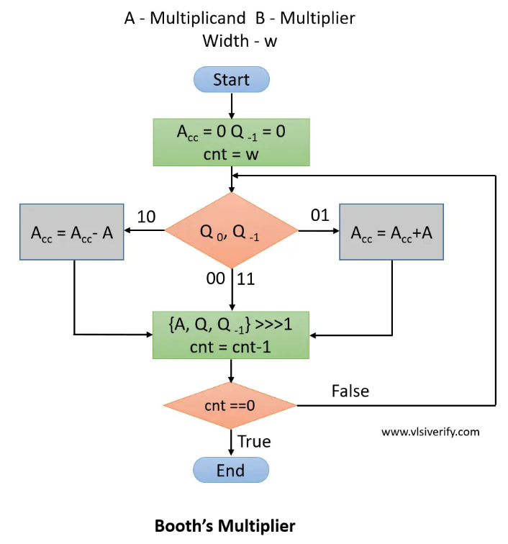
THEORETICAL BACKGROUND
Traditional Booth multiplier
A traditional Booth multiplier works based on decreasing the number of operations (+,-), this makes the multiplication more precise.
It scans the multiplier bits two at a time (including an extra bit, Q₋₁) and decides whether to add, subtract, or shift based on the bit patterns (00, 01, 10, 11).
The process continues until all bits are processed, simplifying signed multiplication and reducing the overall computation time.

Slide 8
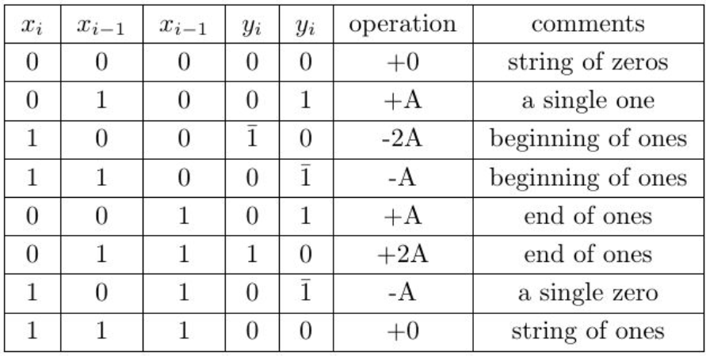
RADIX-4 BOOTH MULTIPLIER
It reduces partial products by encoding patterns into operations such as +A, −A, +2A, or −2A, based on combinations of 0s and 1s.
This method minimizes the number of operations, speeding up multiplication, especially for large numbers, compared to standard Booth encoding.

Slide 9
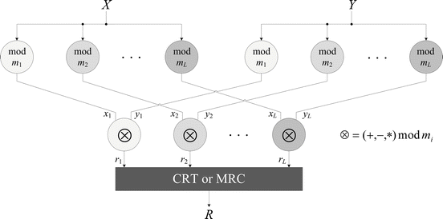
RESIDUE NUMBER SYSTEM(RNS)
This image shows the Residue Number System (RNS) process, where large numbers X and Y are divided into smaller parts using different moduli m1,m2,...,mL​.
Each smaller part is processed independently (addition, subtraction, or multiplication), avoiding carry propagation and speeding up computations.
The results r1,r2,...,rL​ are combined using methods like the Chinese Remainder Theorem (CRT) or the Mixed Radix Conversion (MRC) to get the result R.

Slide 10
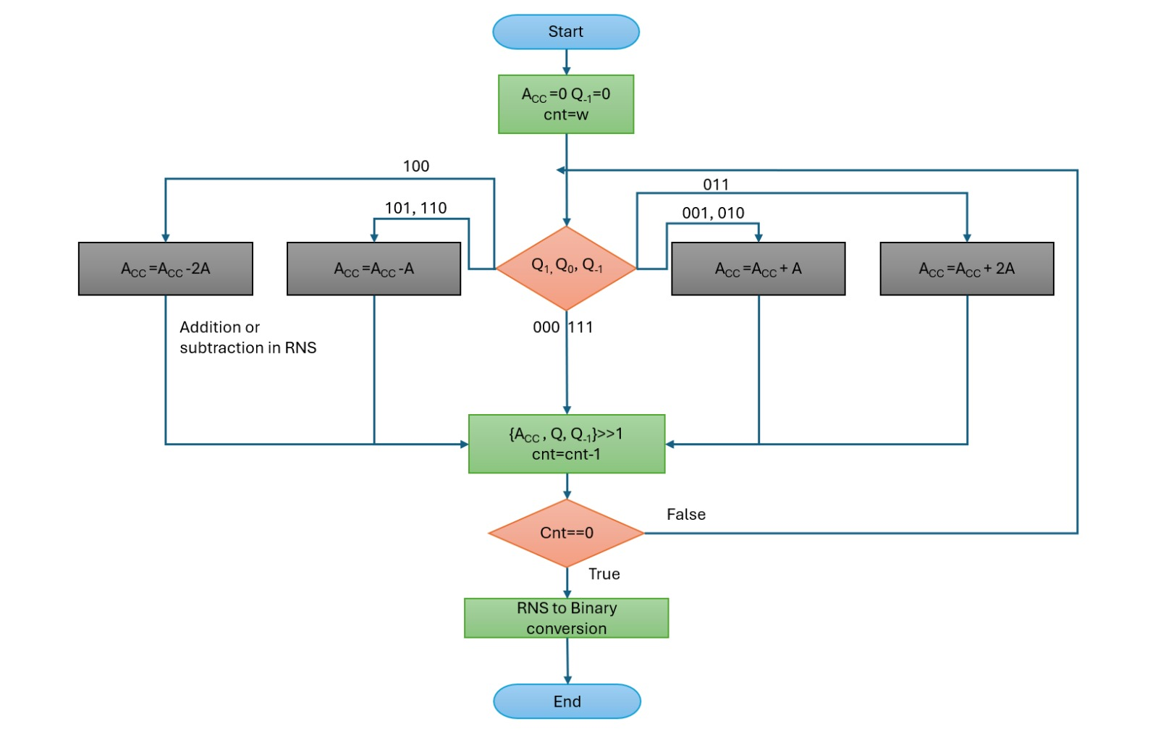
PROPOSED MODEL
The Residue Number System (RNS) breaks large numbers into smaller parts, allowing serial calculations without carry propagation.
When combined with the Radix-4 Booth algorithm, inputs are converted to RNS form, and multiplication happens independently in smaller channels.
The results are combined using methods like the Chinese Remainder Theorem (CRT), improving speed, reducing power use, and enabling scalability for larger operations like 64-bit multiplications.

Slide 11

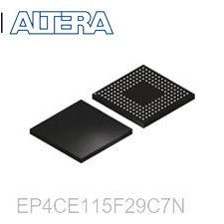
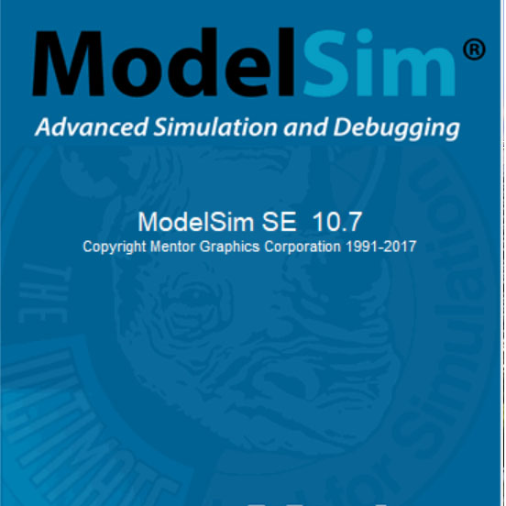

SOFTWARE USED
ModelSim: To simulate and verify the functional correctness of the Verilog code.
Quartus Prime: For code compilation, RTL design visualization, and FPGA-specific placement and routing.
Synopsys Design Compiler: For complete area, power, and timing analysis to optimize the architecture.
FPGA Device: Intel Cyclone IV E FPGA (EP4CE115F29C7) was selected for synthesis and hardware-level validation

Slide 12
PROCEDURE
Design Development
Functional Verification
Synthesis and Analysis
Result Compilation
Hardware Validation
Performance Evaluation

Slide 13
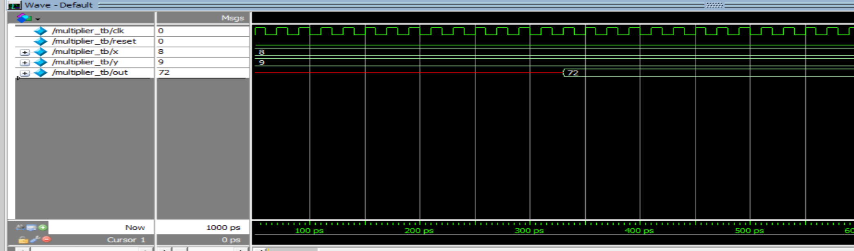
RESULT ANALYSIS

Slide 14
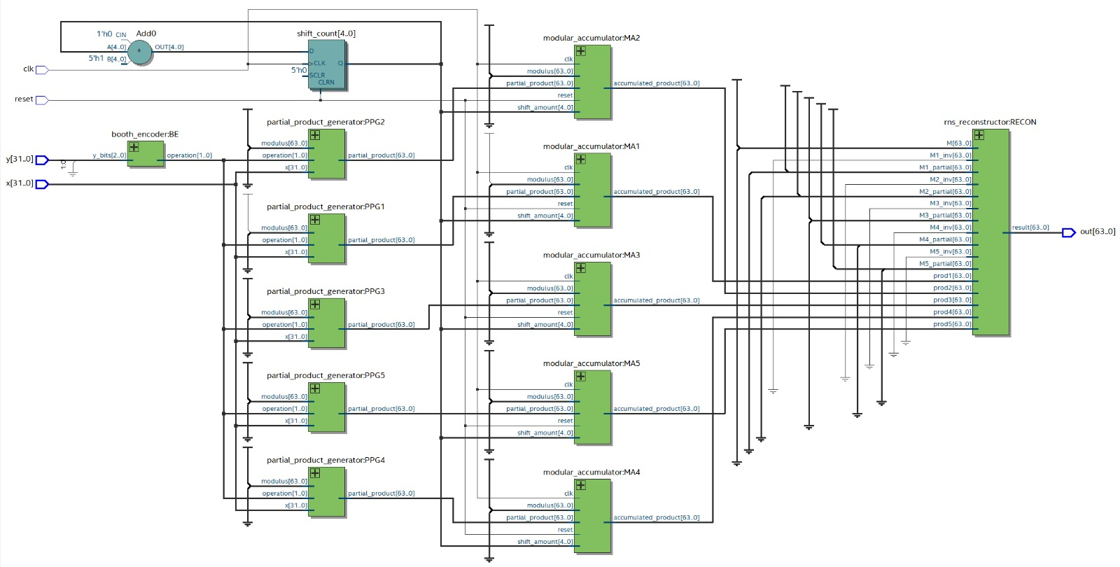
RESULT ANALYSIS

Slide 15
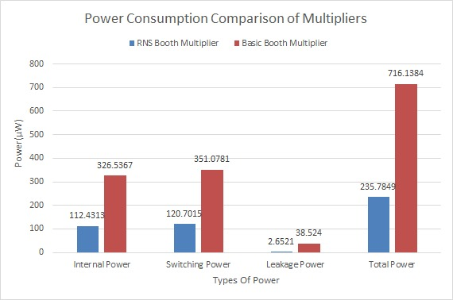
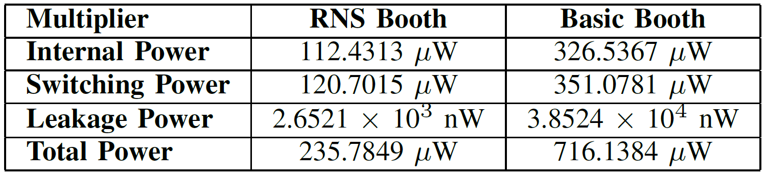
POWER ANALYSIS

Slide 16
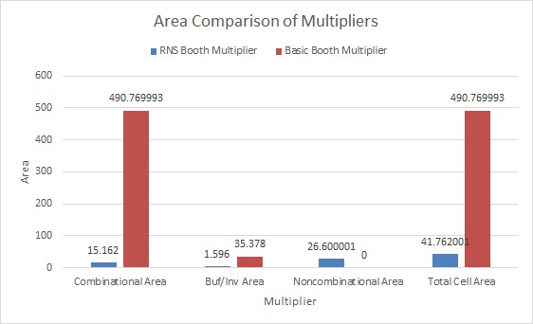
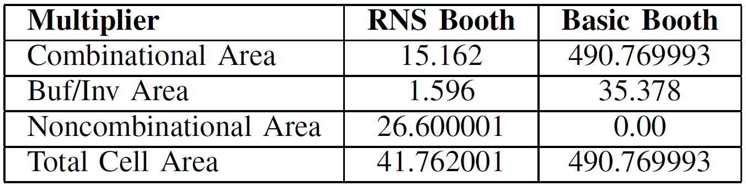
AREA ANALYSIS

Slide 17
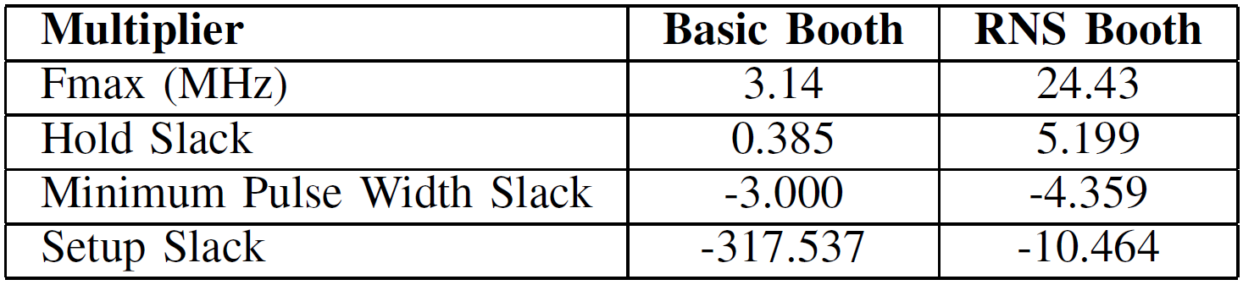
TIMING ANALYSIS

Slide 18
CONCLUSION
We have successfully implemented 32-bit Radix-4 Booth Multiplier using the Residue Number System.
The design has been functionally verified.
The RNS multiplier has shown significant improvement compared to Conventional multiplier in terms of Area, Power and Time.
The RNS Booth Multiplier proves to be a reliable and superior solution for modern computational needs, such as signal processing, cryptography, and embedded systems.

Slide 19
REFERENCES
[1]. Y. -J. Chang, Y. -C. Cheng, S. -C. Liao and C. -H. Hsiao, "A Low Power Radix-4 Booth Multiplier With Pre-Encoded Mechanism," in IEEE Access, vol. 8, pp. 114842-114853, 2020, doi: 10.1109/ACCESS.2020.3003684.
[2]. N. R. Varghese and S. Rajula, "High Speed Low Power Radix 4 Approximate Booth Multiplier," 2019 3rd International Conference on Electronics, Materials Engineering \& Nano-Technology (IEMENTech), Kolkata, India, 2019, pp. 1-4, doi: 10.1109/IEMENTech48150.2019.8981022.
[3]. Duncan J.M. Moss, David Boland, Philip H.W. Leong, "A Two-Speed, Radix-4, Serial-Parallel Multiplier", School of Electrical and Information Engineering, The University of Sydney, Australia 2006.
[4]. D. Younes and P. Steffan, "A comparative study on different moduli sets in residue number system," 2012 International Conference on Computer Systems and Industrial Informatics, Sharjah, United Arab Emirates, 2012, pp. 1-6, doi: 10.1109/ICCSII.2012.6454344.
[5]. D. Kalaiyarasi and M. Saraswathi, "Design of an Efficient High-Speed Radix-4 Booth Multiplier for both Signed and Unsigned Numbers," 2018 Fourth International Conference on Advances in Electrical, Electronics, Information, Communication and Bio-Informatics (AEEICB), Chennai, India, 2018, pp. 1-6, doi: 10.1109/AEEICB.2018.8480959.
[6]. N. R. Varghese and S. Rajula, "High Speed Low Power Radix 4 Approximate Booth Multiplier," 2019 3rd International Conference on Electronics, Materials Engineering \& Nano-Technology (IEMENTech), Kolkata, India, 2019, pp. 1-4, doi:10.1109/IEMENTech48150.2019.8981022

Slide 20
THANK YOU

